Slide 1


AI Section 2: Sources of Data and Data Types

Slide 2

Let’s break the ice!
If you could collaborate with any YouTuber, who would it be and why?
“Iceberg Jökulsárlón” by Marco Ottobelli is licensed under CC BY-SA 4.0

Slide 3
Focus Question
Before beginning, take a moment to think about data that could be stored in a variable and how it could be differentiated based on its type.
Why do we separate data into 'types'?
Think about the different ways we store and convey information:
Statistics?
Numbers?
Characters?

Slide 4
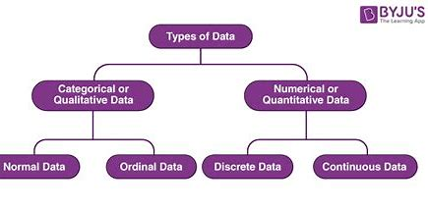

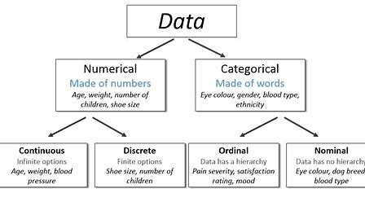
What are Types of Data
How does it match up with the graphics below?
Watch this video on Data Types and Variables
Images from BYU and AskDataScience.com

Slide 5
Data Types
Data can be categorized into two main types based on if they are composed of words or numbers. There are other data types we will also learn about next.
The term “data type” in software programming describes the kind of value a variable possesses and the kinds of mathematical, relational, or logical operations that can be performed on it without leading to an error.
Numerous programming languages, for instance, utilize the data types string, integer, and floating point to represent text, whole numbers, and values with decimal points, respectively.

Slide 6
Data Types
An interpreter or compiler can determine how a programmer plans to use a given set of data by looking up its data type.
The data comes in different forms. Examples include:
your name – a string of characters
your age – usually an integer
the amount of money in your pocket- usually decimal type
today’s date – written in date time format

Slide 7
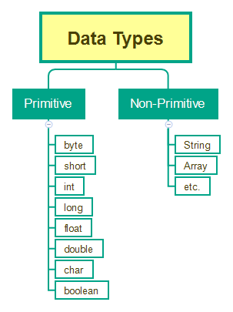
Data Types
Data is usually categorized as Primitive or non-primitive based on how it is put together.
Image from Java for Testers – Using Data Types - QAFox

Slide 8
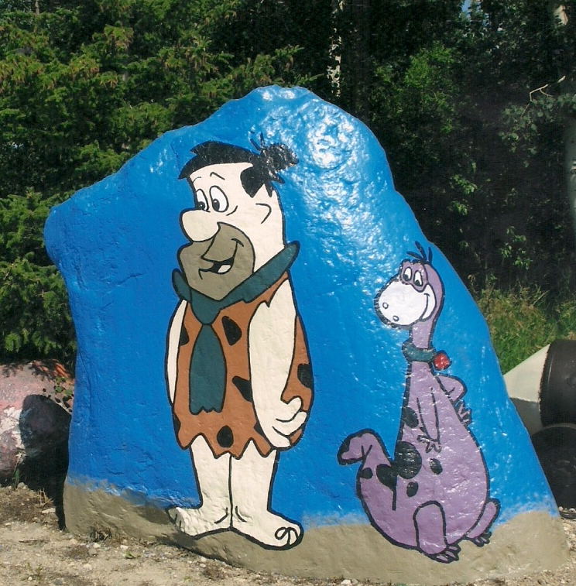
Primitive Data Types
Primitive Data Types are predefined data types that include basic values like text or numbers.
They are the most fundamental type of data and are used as the foundation for more complex data types.
Most computer languages probably employ some variation of these simple data types.
Common types of primitive data from Data Types in Programming – GeeksforGeeks.

Slide 9
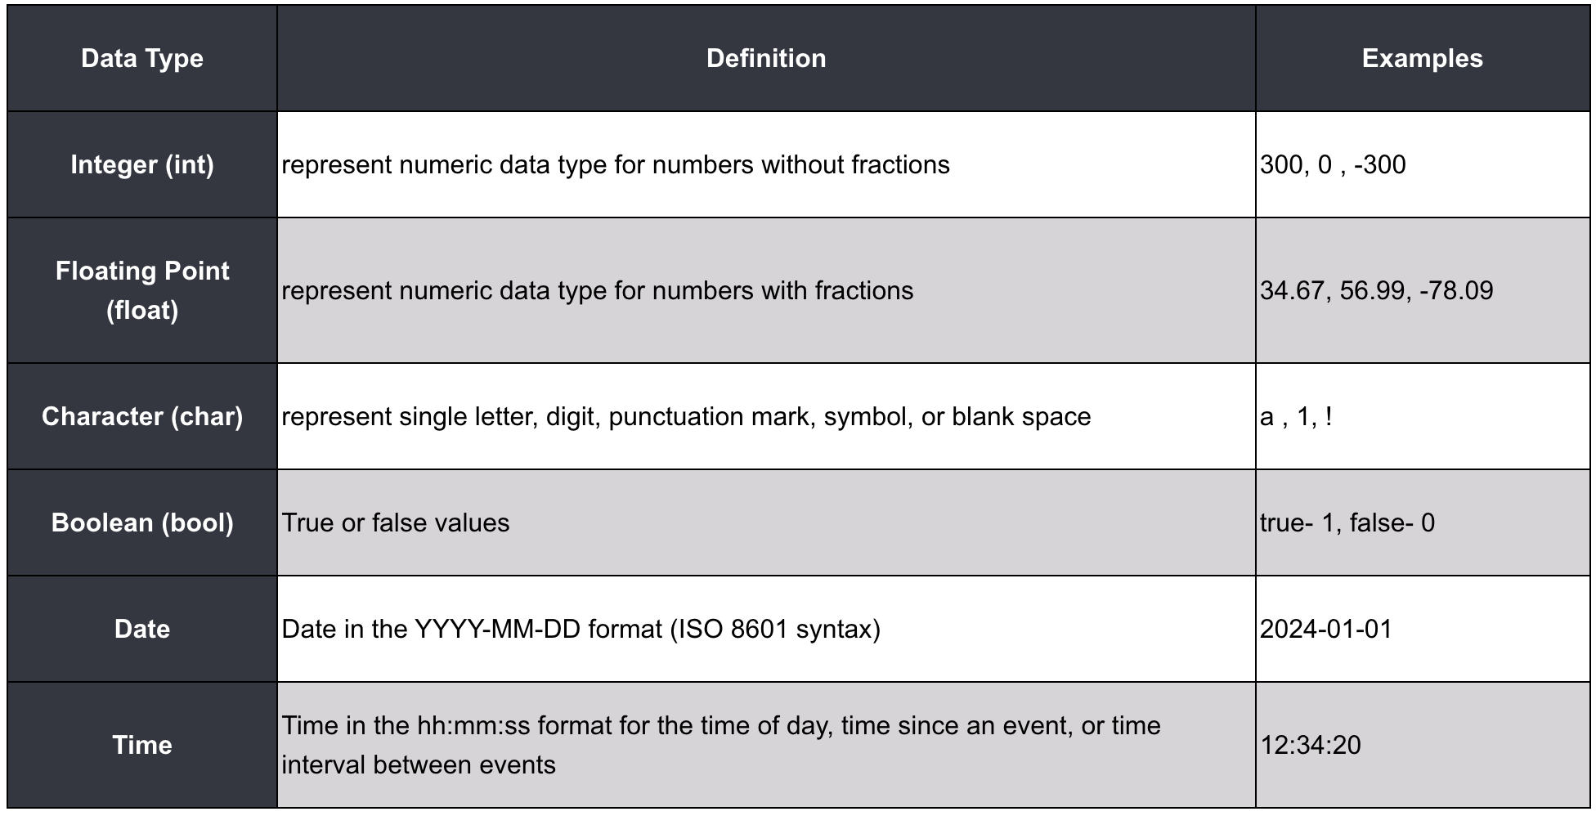
Primitive Data Types
Some common primitive datatypes are as follow:

Slide 10
Other Data Types
There are other data types as well! Composite types fall into four main categories:
semi-structured (stores data as a set of relationships);
multimedia (stores data as images, music, or videos);
homogeneous (needs all values to be of the same data type)
tabular (stores data in tabular form).
Non-primitive data types contain data that you put together as an "object" There are 4 main types of non-primitive data types: String, Class, Array, and Interface.

Slide 11
Other Data Types - Strings
Strings are a group of characters surrounded by double-quotes.
Strings are mostly used to store chunks of text and information.
Under the hood, this class is actually storing each character inside of an array, so if you make a string that holds your name “Beyonce”.
What that string will really look like is {‘B’, ‘e’, ‘y’, ‘o’, ‘n’, ‘c', ‘e’}, this makes it possible to access each character individually like an array.
The String class has a lot of methods that we can use to manipulate strings.

Slide 12

Other Data Types - Arrays
Arrays are a way of storing information in a “list” format.
Arrays are very helpful when we store data that will not have a lot of added elements, for lists that require more manipulation there are Linked Lists.
Arrays can’t store integers or anything not wrapped in quotations.
Array ={"Beyonce", "42", “songwriter”}

Slide 13
What types of data are used in computer programming?
Strictly speaking, a data type is a classification that determines what type of value a variable can have, which in turn determines what type of mathematical and logical operators can be applied to the variable.
You may look at the above definition with great confusion. A simpler way is to think about a data type as something akin to a label that tells you what information you are holding and how you can interact or manipulate it.

Slide 14
Variable Categories
Below is an overview of all common variable categories by type:
Numeric Variables
int -> Used to store integer values (whole numbers).
float -> Used to store floating-point values (decimal numbers).
String Variables
str -> Used to store text or string values. Strings are enclosed in single or double quotes.
Boolean Variables
bool -> Used to store boolean values (True or False), which represent binary conditions.

Slide 15
Variable Categories Continued
Sequence Variables
list -> Modifiable collection of values / elements.
tuple -> Non-modifiable collection of values / elements.
Mapping Variables
dict -> Known to humans as dictionaries. These are used to store key-value pairs, where a key is a unique sequence of characters that corresponds to a value that can be of any type. These key-value pairs are important when we dive deeper into this variable type.

Slide 16

Data Types? What Data Types?
MATLAB has a several data types, but we will be covering the four core data types that serve as the backbone of this programming language and on which other data types are built.
Let us first give a simple overview of each of these data types before we examine them in greater detail.

Slide 17
Data Types? What Data Types?
Numeric Types Integer and floating-point data
Characters and Strings Text in character arrays and string arrays
Dates and Time Arrays of date and time values that can be displayed in different formats
Categorical Arrays Arrays of qualitative data with values from a finite set of discrete, nonnumeric data
Tables Arrays in tabular form whose named columns can have different types
Timetables Time-stamped data in tabular form
Structures Arrays with named fields that can contain data of varying types and sizes

Slide 18
Data Types? What Data Types?
Cell Arrays Arrays that can contain data of varying types and sizes
Function Handles Variables that allow you to invoke a function indirectly
Dictionaries Map data with keys that index values
Time Series Data vectors sampled over time
Data Type Identification Determine data type of a variable
Data Type Conversion Convert between numeric arrays, strings and character arrays, dates and times, cell arrays, structures, or tables

Slide 19
Type Casting in Programming:
Converting a single data type value—such as an integer int, float, or double—into another data type is known as type casting. You have the option of doing this conversion manually or automatically. The conversion is done in two ways, automatically by the compiler and manually by a programmer.
Type casting is sometimes known as type conversion. For example, a programmer can type cast a long variable value into an int if they wish to store it in the program as a simple integer. Thus, type casting is a technique that allows users to utilize the cast operator to change values from one data type to another.
Type casting is used when imagine you have an age value, let’s say 30, stored in a program. You want to display a message on a website or application that says “Your age is: 30 years.” To display it as part of the message (a string), you would need to convert the age (an integer) to a string.

Slide 20
Type Casting in Programming:
Simple explanation of type casting can be done by this example:
Imagine you have two types of containers: one for numbers and one for words. Now, let’s say you have a number written on a piece of paper, like “42,” and you want to put it in the container meant for words. Type casting is like taking that number, converting it into words, and then putting it in the container for words. Similarly, in programming, you might have a number (like 42) stored as one type, and you want to use it as if it were another type (like a word or text). Type casting helps you make that conversion.

Slide 21

To Do: YouTube Conundrum – Part 1
Imagine that you want to collect various metrics on a YouTube video that you uploaded that garnered significant attention, with tens of thousands of likes and over 10 million views. You want to store the title, view count, number of likes, number of dislikes and your username “STUDENT001.”
Unfortunately, due to your lazy lifestyle, you feel that you do not want to categorize this information yourself and want a program to do it for you. With a low grunt and frustration, you hesitate and decide to delve into programming to solve this painstaking task to save five minutes of your time.
Let us think about this situation in a programming context by storing all these attributes in variables and discussing the following questions. You are free to brainstorm answers to these questions with your fellow classmates.
“MrBeast in 2022 (cropped)” by Fidias is licensed under CC BY 3.0

Slide 22
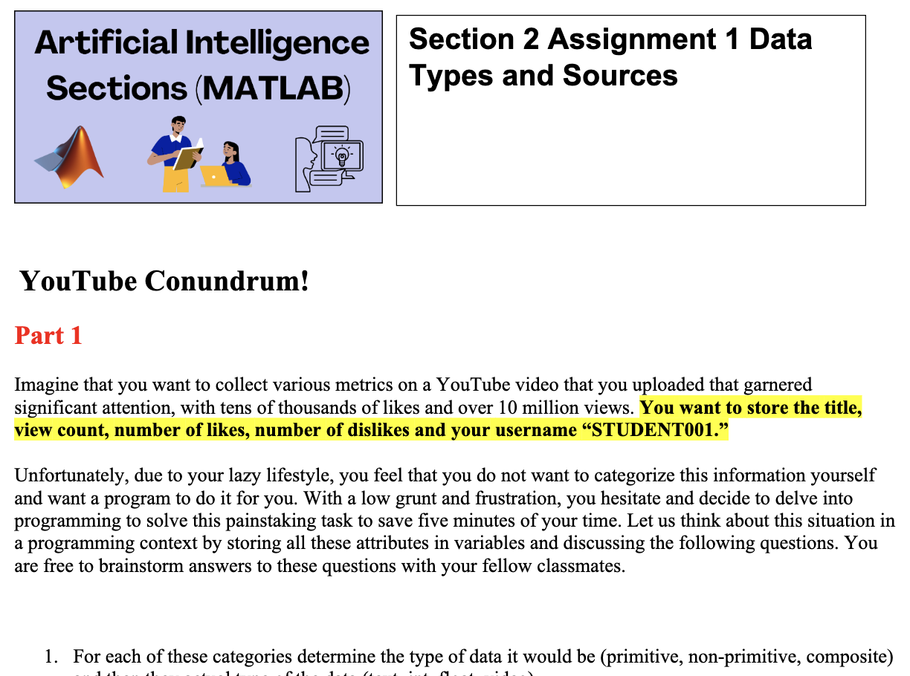
To Do: YouTube Conundrum – Part 1
Use the worksheet to record your responses to the following:
For each of these categories determine the type of data it would be (primitive, non-primitive, composite) and then they actual type of the data (text, int, float, video)
What do you think would differentiate each of these variables in terms of value and type?

Slide 23
To Do: YouTube Conundrum – Part 1
Suppose that you also decided to change your username that day and added an extra “1” to your username. What would happen if you tried to add a “1” to the variable that stores your username, if even feasible?
Finally, imagine that robots take over the world and force you to change your name to a series of numbers that no longer contains any non-numerical characters. You are forced to update your “name” variable. What is the best approach to doing so: creating a new variable or overwriting your already-existing variable that is of a different data type?

Slide 24
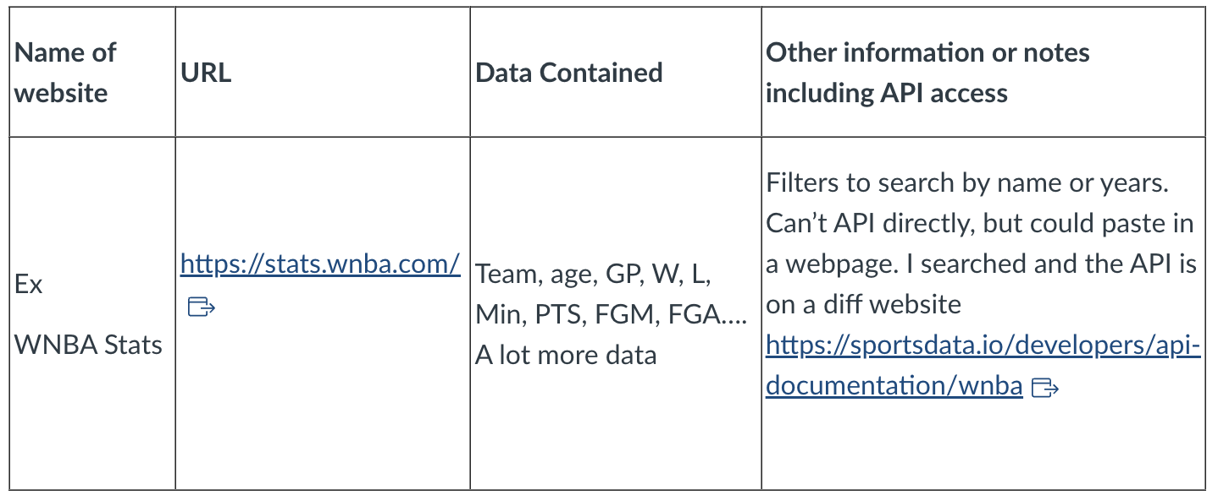
To Do: YouTube Conundrum – Part 2
Go back to the worksheet you made in Section 1 (Lesson 1) Part 2 Understanding the roll of data in A & R and Sports Analytics. (see example table below)
Pick one sports data site and one Music data site.

Slide 25
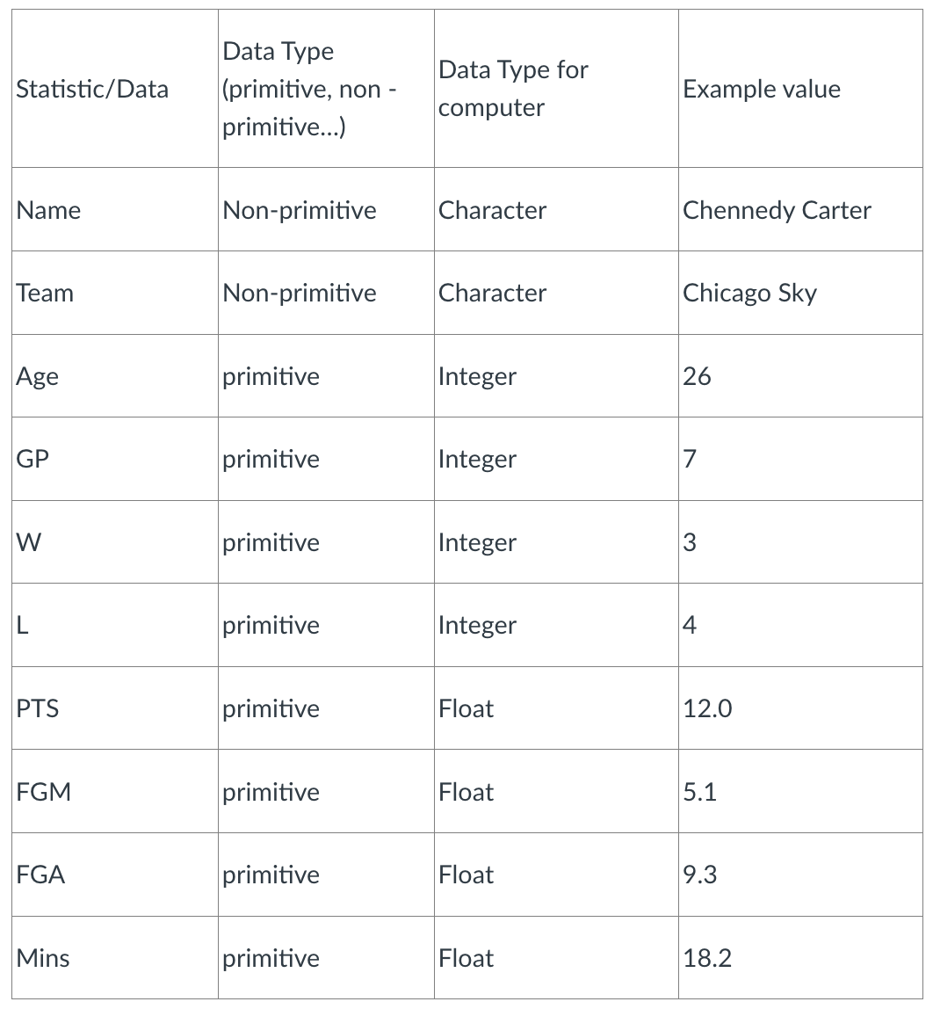
To Do: YouTube Conundrum – Part 2
For each of the websites you picked, make a new table where you take the values from “Data Contained” column below and tell the data type and give an example, you may need to go back to the site to look at it.
You will need at least 8-10 examples of data types from this source.
EX: Website sports - WNBA

